Slide 1

REAL OR FAKE
JOB PREDICTION

Slide 2
TABLE OF CONTENTS
01
02
03
Concluding Remarks
Introduction
Findings
(Data Preparation, Data Analysis, Data Modeling)

Slide 3
UNDERSTANDING THE PROBLEM
For many people, economic hardship and the impact of the coronavirus have drastically reduced work availability and resulted in job loss.
According to the FBI, the overall percentage for employment scams is 15.6%
The process of searching for new employment is one of the most difficult issues that recent college graduate experience. Scammers utilize this in order to lure individuals seeking for employment into scams and profit from them in a variety of ways.

Slide 4
Libraries used
NumPy is a library for the Python programming language, adding support for large, multi- dimensional arrays and matrices, along with a large collection of high-level mathematical functions to operate on these arrays.
Pandas is a data manipulation and analysis software package for Python, It includes data structures and methods for manipulating numerical tables
Seaborn is a library for making statistical graphics in Python. It builds on top of matplotlib and integrates closely with pandas data structures
Matplotlib is a plotting library for the Python programming language and its numerical mathematics extension NumPy

Slide 5
Libraries used
Scikit-learn (SKlearn) is a library for machine learning within Python including classification, regression, clustering, and reduction.
train_test_split (splitting data arrays into subsets)
confusion_matrix (summary of the number of correct and incorrect predictions made by our classifier)
classification_report (performance evaluation metric in machine learning)

Slide 6
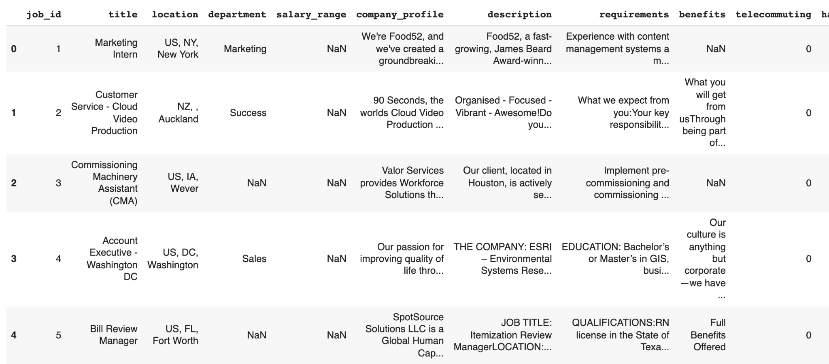
Data Summary

Slide 7
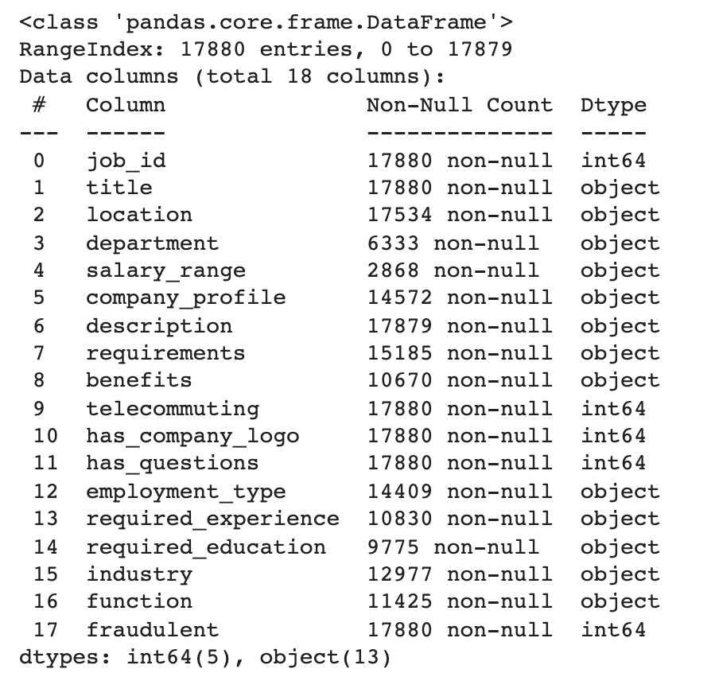
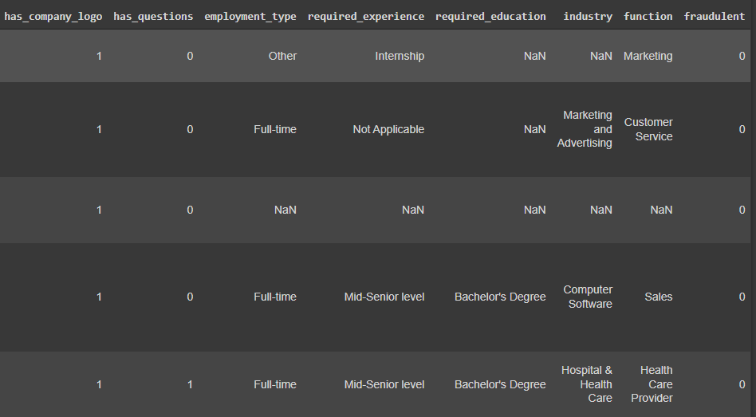
Data Summary

Slide 8
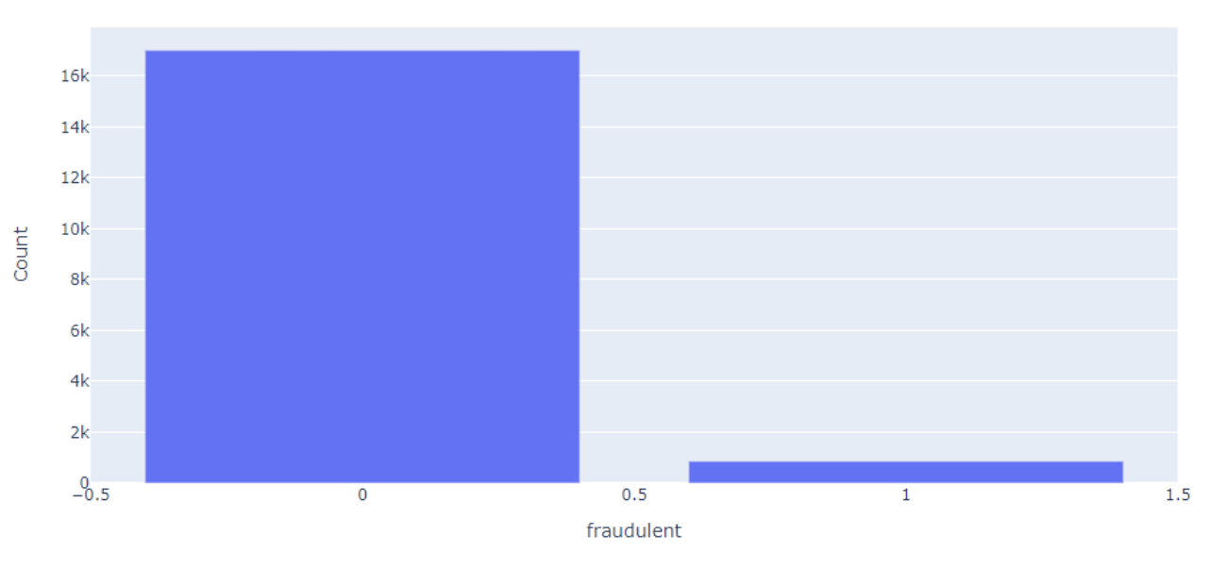
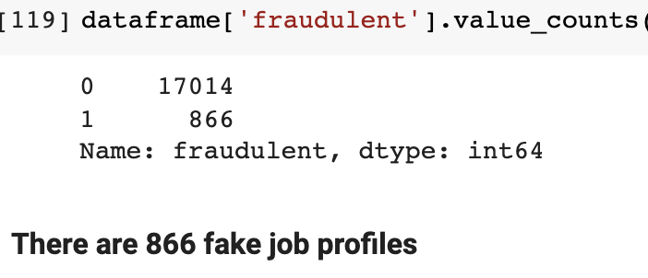
Fraudulent VS Non-Fraudulent Job Postings
4.8% of the job postings are fraudulent
1 = fraud
0 = real job posting

Slide 9
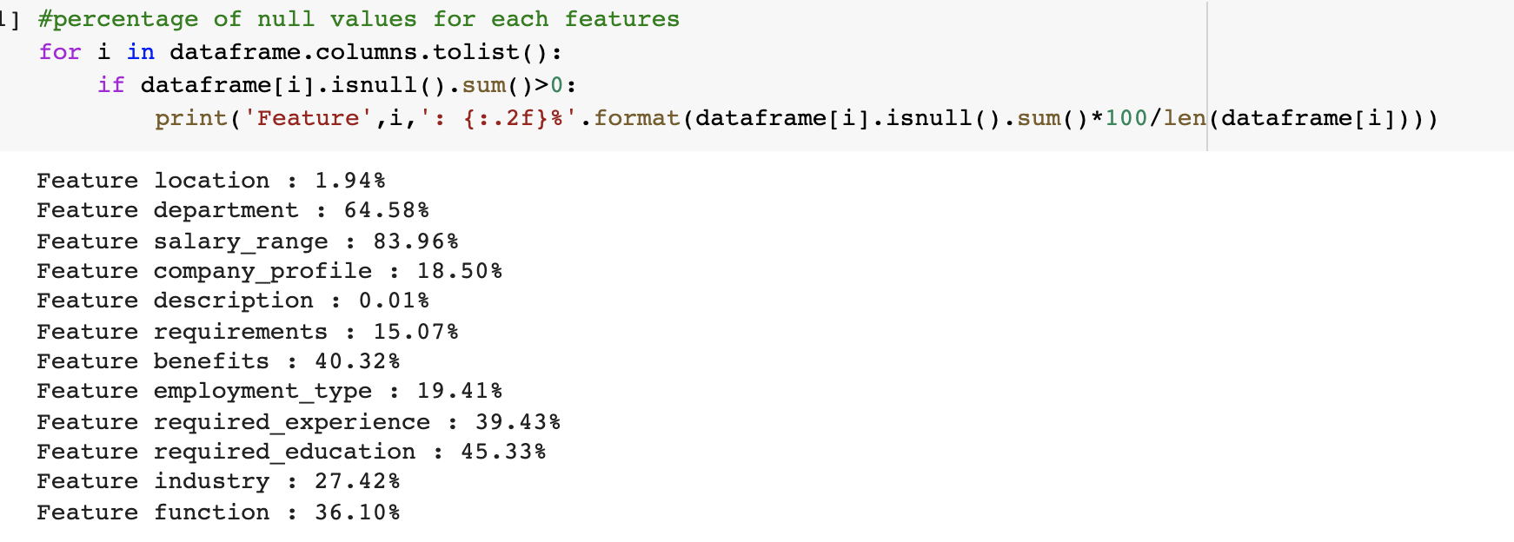
Data Preparation
The column ‘salary_range’ had > 80% missing data, so we dropped it from the data set

Slide 10
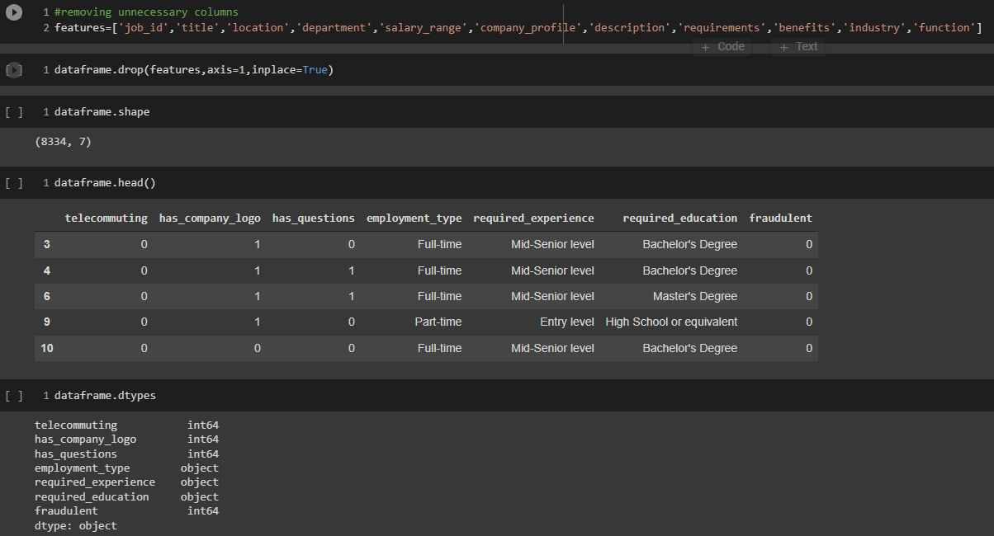
Data Preparation

Slide 11
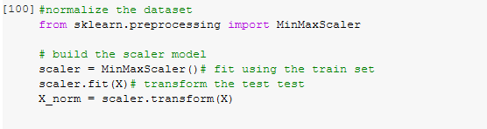
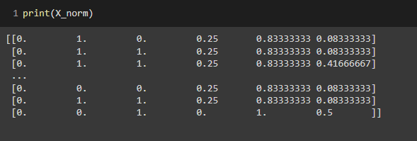
Data Preparation
Normalizing data

Slide 12
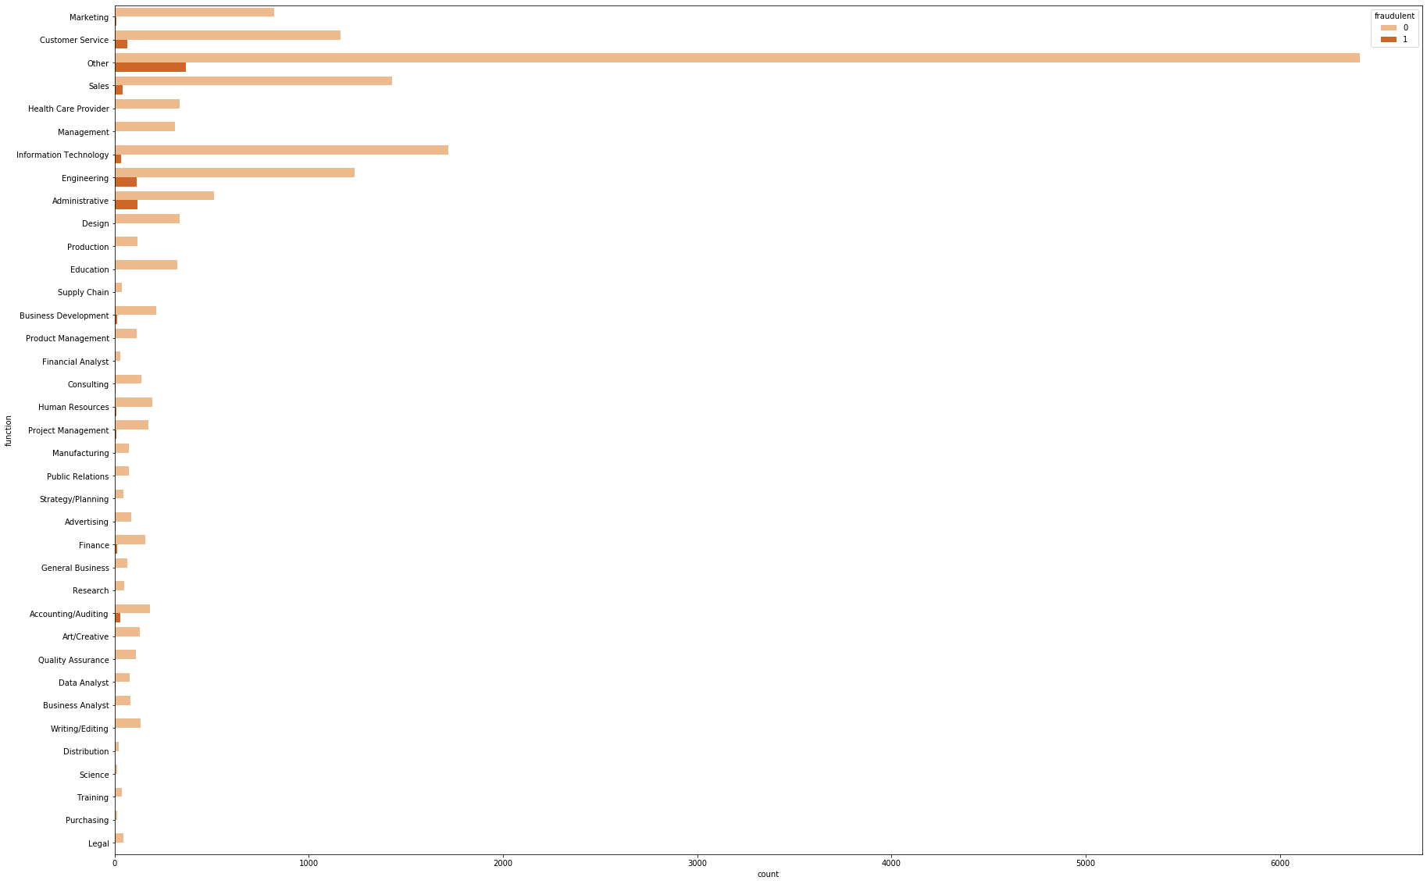
Plotting incidence of fraud by the job function shows that Administrative and Engineering have the highest levels of fraudulent postings.
Findings

Slide 13
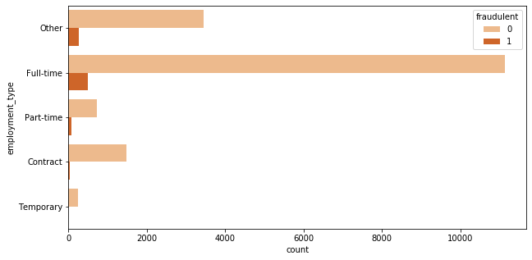
Jobs Postings which are of the type Full-time have higher instances of fraudulent postings
Findings

Slide 14
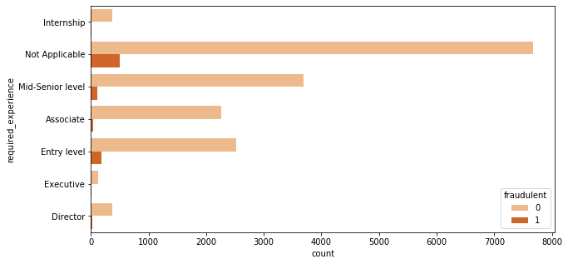
Plotting incidence of fraud by the required experience shows that entry and mid-senior level postings have the highest incidence of fraud
Findings

Slide 15
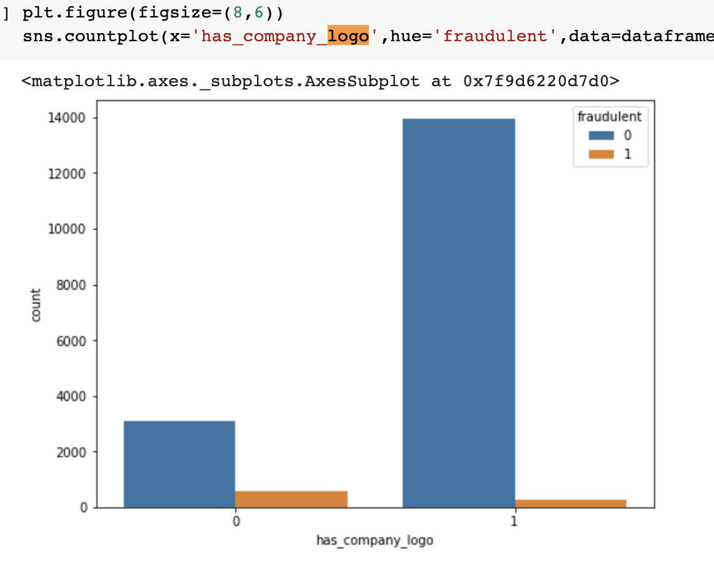
Plotting incidence of fraud by whether or not there is a company logo shows that postings with no company logo have a higher incidence of fraud.
Findings

Slide 16
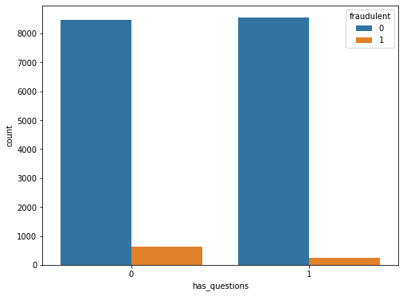
Fraud postings have an extremely small window of asking questions.
Findings

Slide 17
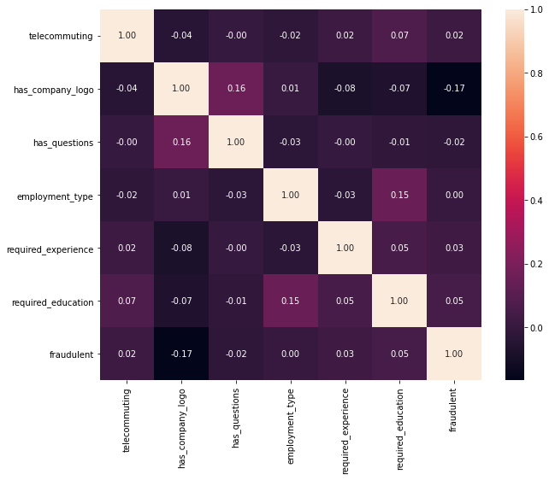
Learning Classifier Model

Slide 18
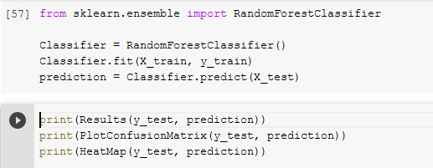
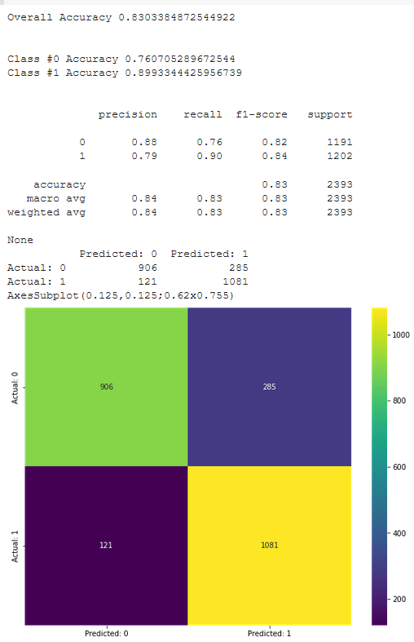
Data Models and Analytics (Random Forest)

Slide 19
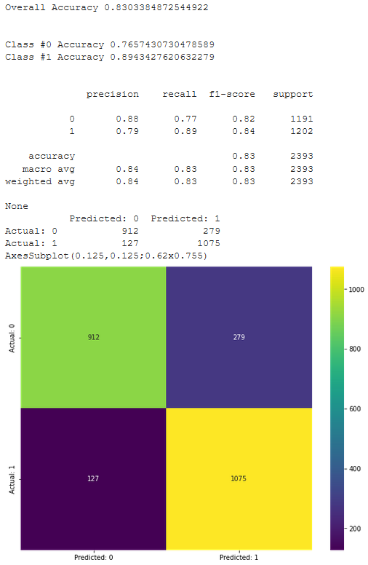
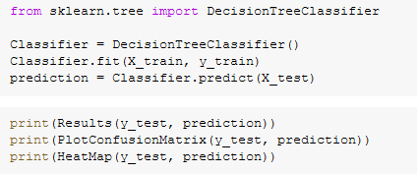
Data Models and Analytics
(Decision Tree)

Slide 20
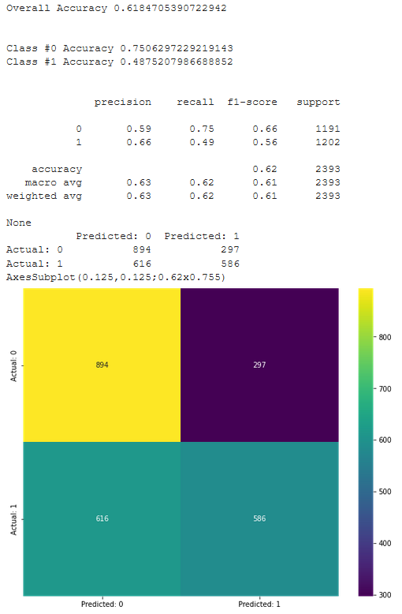
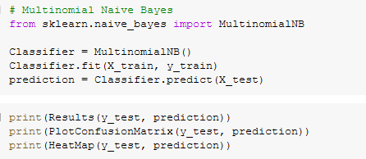
Data models and Analytics
(Naive Bayes)

Slide 21
Conclusion
Plotting incidence of fraud by the job function shows Administrative and Engineering, Full-time and mid-senior have the highest levels of fraudulent postings. So we should ensure to strictly meet function, employment type and required experience.
Using Random forest, we inferred that “company_logo” is playing a significant role in identifying a job as fake or not. So companies should ensure to have a company logo while posting jobs.
Using Decision Tree by adjusting the threshold we are able to get overall accuracy 83. 03 for identifying for the jobs
After applying text analytics, result prediction of all models indicated that this problem was high sensitivity and low specificity problem.
We identified different classification machine learning algorithms to see which would result in the highest classification accuracy if a job was fast.

Slide 22
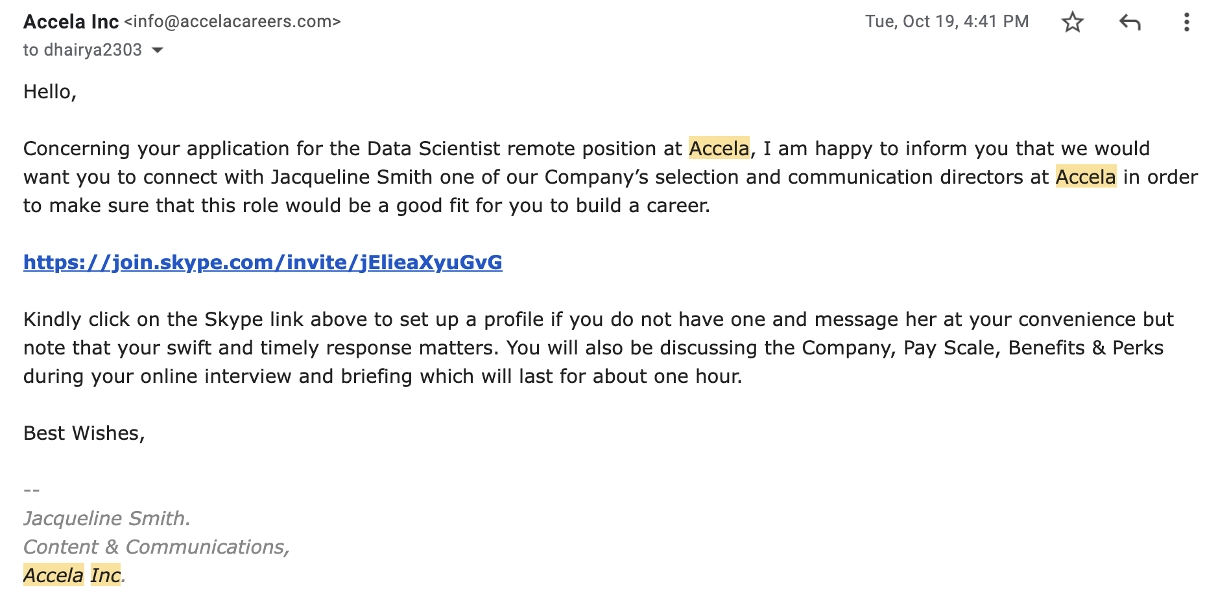
Conclusion

Slide 23
Any questions?
Thank you!

